Slide 1
DS-GA 3001 ADVANCED PYTHON PROJECT VIDEO GAME IMPLEMENATION PAC-MAN
Zhe Huang (zh1087), Jonathan Platt (jdp322), Daoyang Shan (DS5471), TIANYU WANG (TW1682)

Slide 2
BACKGROUND
Pac-man is originally an arcade game designed by NAMCO that was first released in 1980
Pac-man is one of the highest-grossing video games of all time, having generated more than $2.5 billion in quarters by the 1990s (Wikipedia)
Game variables
Pac-man
Ghosts
Maze
Pac-dots
Power pellets
Number of lives
Game objective: Accumulate as many points as possible by collecting the dots and eating ghosts & fruit
Level 256: more fruit than ability to place fruit led to bug, $100k unclaimed prize as no one could beat this level before Jan. 1st 2000

Slide 3
PAC-MAN DEMO
https://www.youtube.com/watch?v=1V7uBxNXOzo

Slide 4
PAC-MAN FRAMEWORK
PAC-MAN game development projects have been routinely part of Stanford and Berkeley’s AI courses
We will be using and modifying their existing framework
Current Python 2.7 Framework (3,000+ lines of code)
The core infrastructure will integrate all the main components into the game and handle the essential mechanisms of this game (iterations, winning/losing conditions, etc.)
UI rendering module
Keyboard input handler
Ghost agents – automated logic
Pac-man agent – user controlled

Slide 5
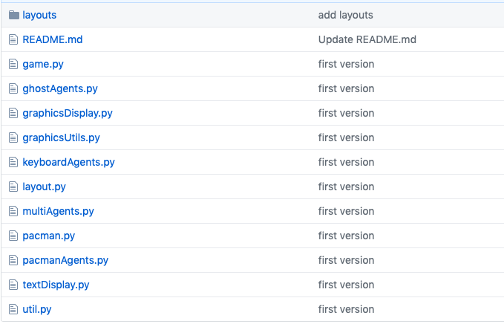
Current GiT REPOSITORY

Slide 6
PROJECT OVERVIEW
Convert code from Python 2 to Python 3
Incorporate advanced Python programming techniques covered in class
Adding/modifying advanced features with efficient Python programming
Gaming features and infrastructure
More ghost movement logic
(Optional) Automatic Pac-man -> implement an intelligent Pac-man agent

Slide 7
Project DETAILED — Core infrastructure
Adding more gaming rules and features
More power-ups, shields, number of ghosts, extra lives, etc.
New UI components
Game menu, customized game theme
Re-factoring infrastructure
Optimize the main process
Sequential agent handling -> Parallel agent handling? (Optional)

Slide 8
Project DETAILED — Ghost logic
Currently we have two vanilla ghost strategy (how ghost agents move based on Pac-man’s location?)
Random movement
Movement to location based on minimum Manhattan Distance to Pac-man
Plan to implement more ghost logic
Distance measures that incorporate maze walls
Other types of distance measures

Slide 9
PROJECT DETAILED — Automatic Pac-man agent (OPTIONAL)
Instead of controlling Pac-man by ourselves, can we implement a Pac-man that automatically decides next actions based on current situation?
Various potential algorithms and corresponding evaluation methods (as suggest on the original class material)
Involves some material beyond this course scope—but should be interesting!

Slide 10
ANY QUESTIONS?

